Slide 1


Spanning Set: If $v_{1},v_{2},…,v_{r}$in a vector space 𝑉, then set of all linear combination of the vectors $v_{1},v_{2},…,v_{r}$is denoted by span{$v_{1},v_{2},…,v_{r}$}=W is a subspace in V generated or spanned by $v_{1},v_{2},…,v_{r}$.

Slide 2
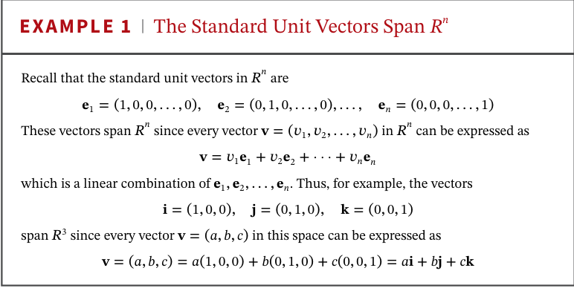

Slide 3
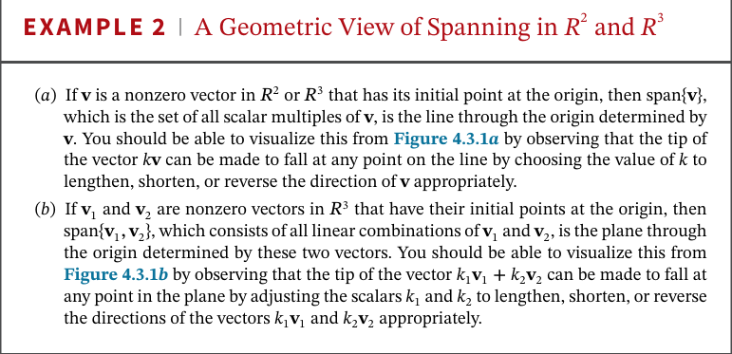
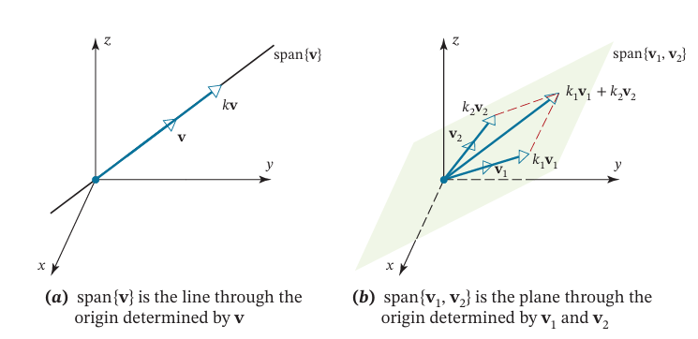

Slide 4
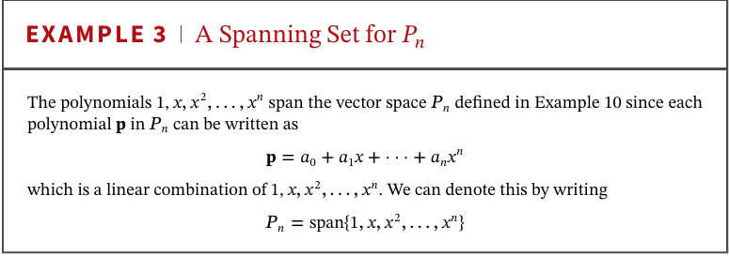

Slide 5
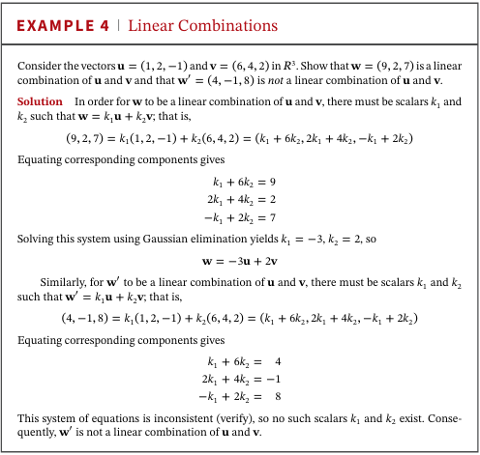

Slide 6

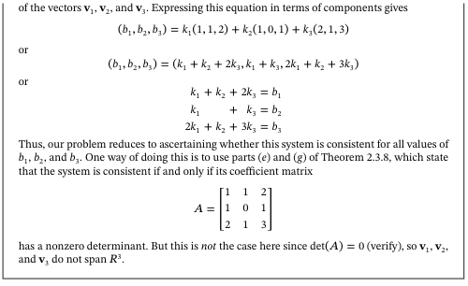

Slide 7
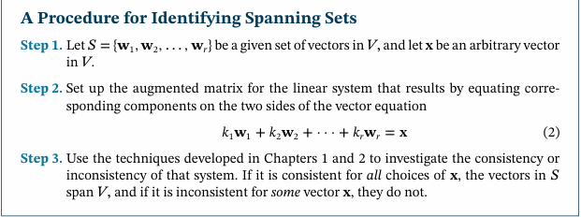

Slide 8
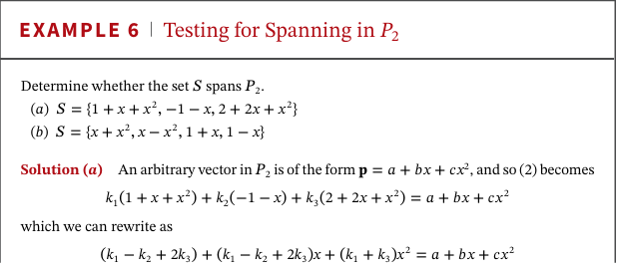

Slide 9
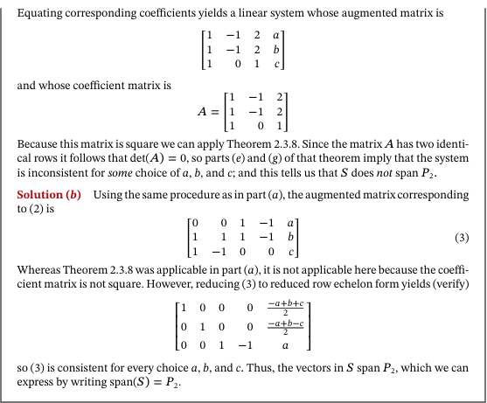

Slide 10
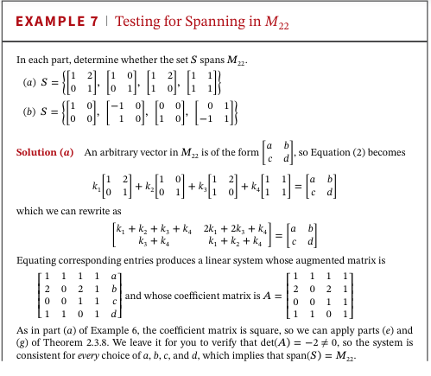

Slide 11


Slide 12


